Slide 1
C Programming Group Project
By:
Thanapoom Tanalakwong (64011667)
Jade Chuapakdee (64011397)
Panop Pitchayathorn (64011736)

Slide 2
Introduction
The Project we decided on is the Food Ordering System
The user can sort the food they want either by restaurant or by menu
Then when the order is done it will go to the cart and the program will end
The language mainly used is going to be C, with the stdio.h, stdlib.h, and the string.h libraries
We divided our work by a section, so one person took on the main and the restaurant_initialize, one person took finding by restaurant, and one person took finding by order
We then combined it all together and did the cart function together and checked for any bugs we could have missed

Slide 3
Knowledge being used from class
We used a lot of functions and calling
We used if loops and some while loops
We used arrays and pointers (but not really any pointer arithmetic)
We also used structures (struct)

Slide 4
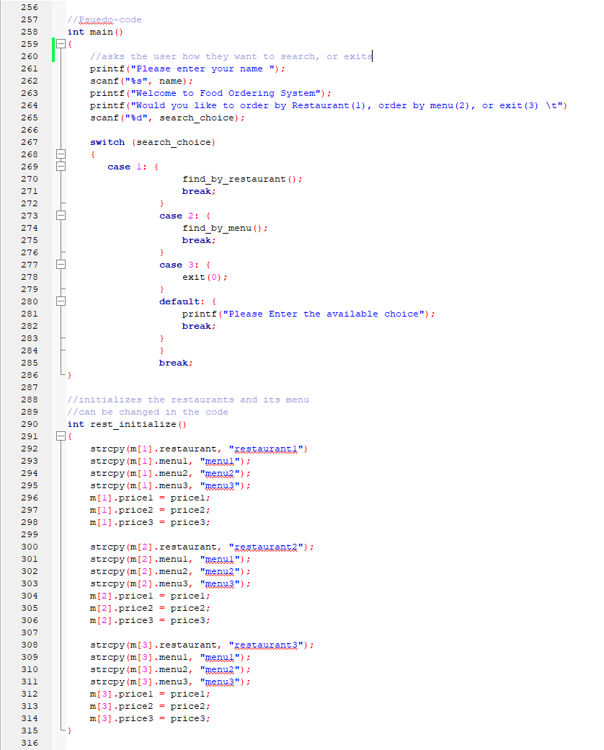
Pseudo-Code

Slide 5
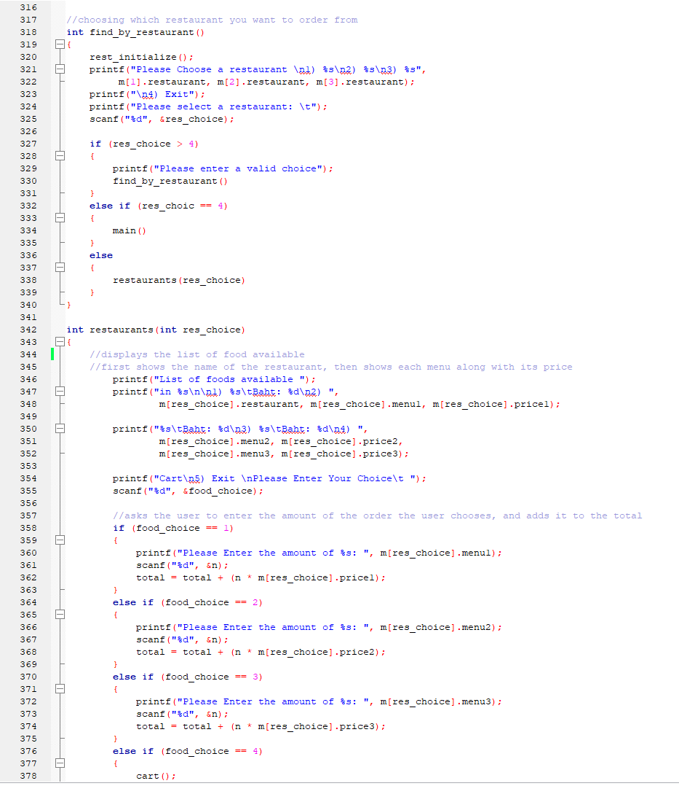
Pseudo-Code

Slide 6
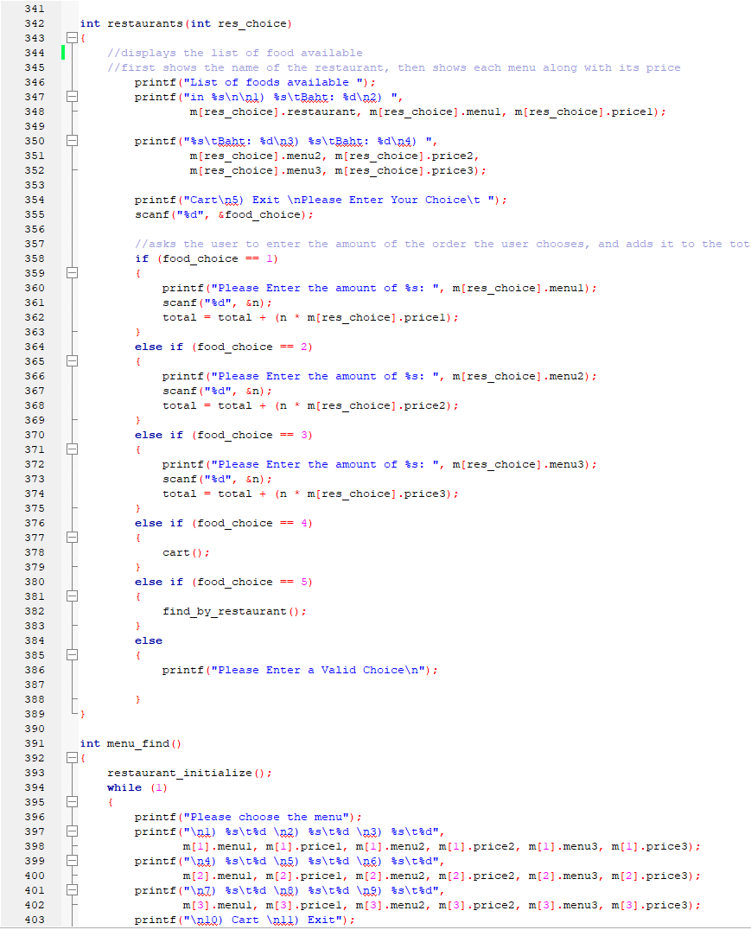
Pseudo-Code

Slide 7
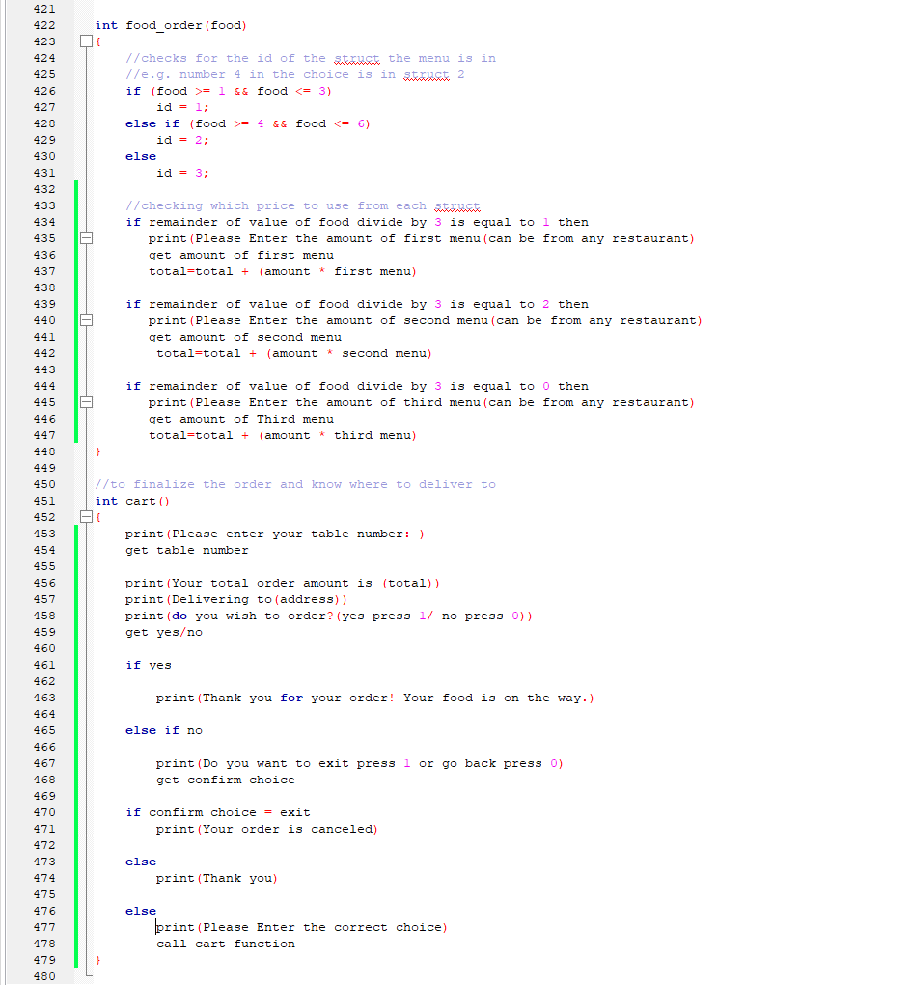
Pseudo-Code

Slide 8
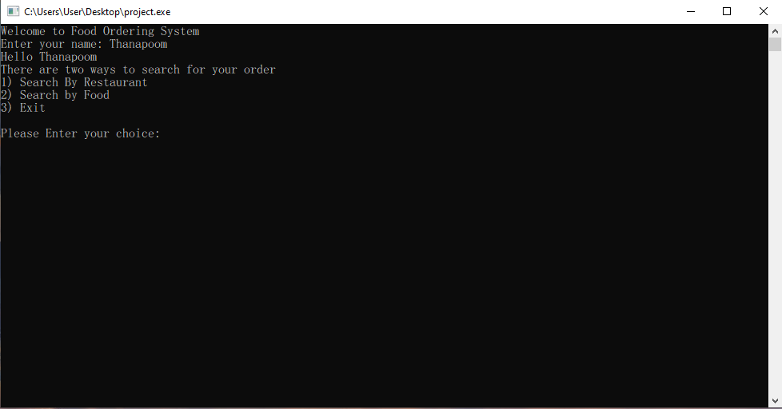
Features of the Program
The program allows the user to chose how to order their food (by restaurant or by menu)

Slide 9
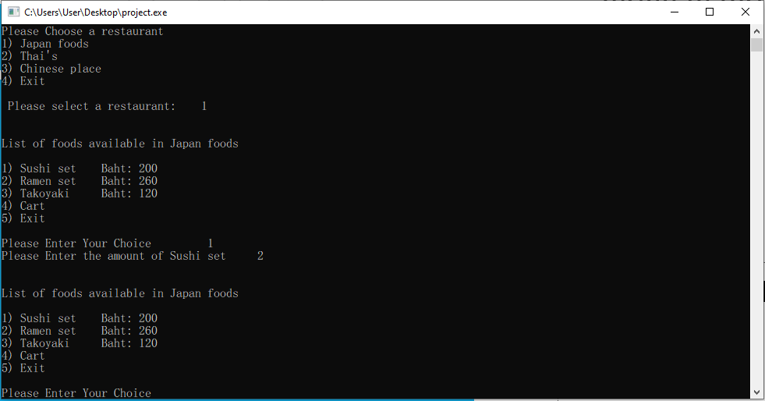
Features of the Program
If the user selects order by restaurant, the program then prompts the user to choose a restaurant and then the menu in the restaurant as well as the amount

Slide 10
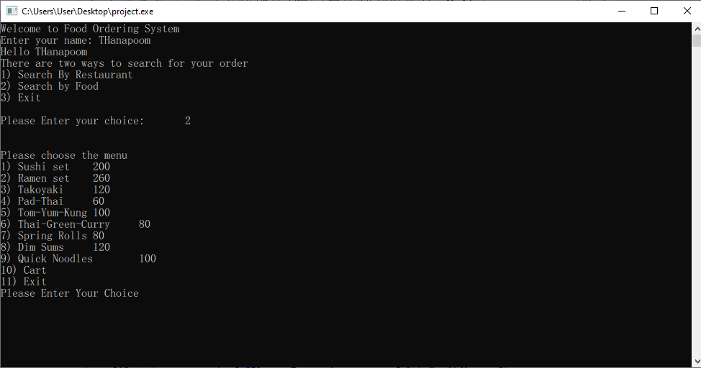
Features of the Program
If the user chooses to order by menu, the program will show the menu of all the restaurants and let the user choose what they want and the amount

Slide 11
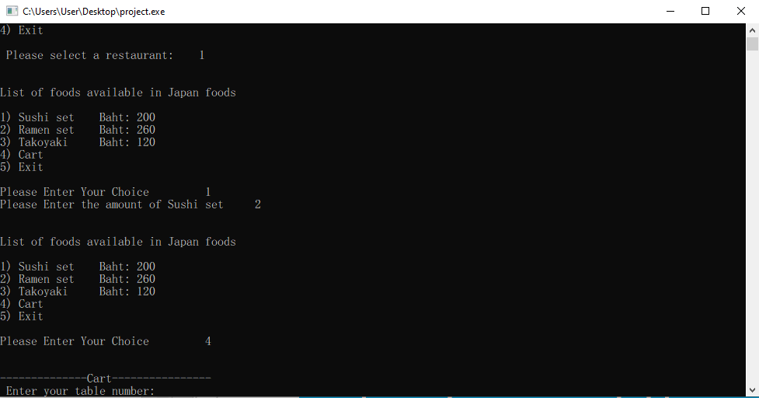
Features of the Program
When the user is satisfied with their order and chooses the cart option, the program ask for the user’s table number and show the price of the order

Slide 12
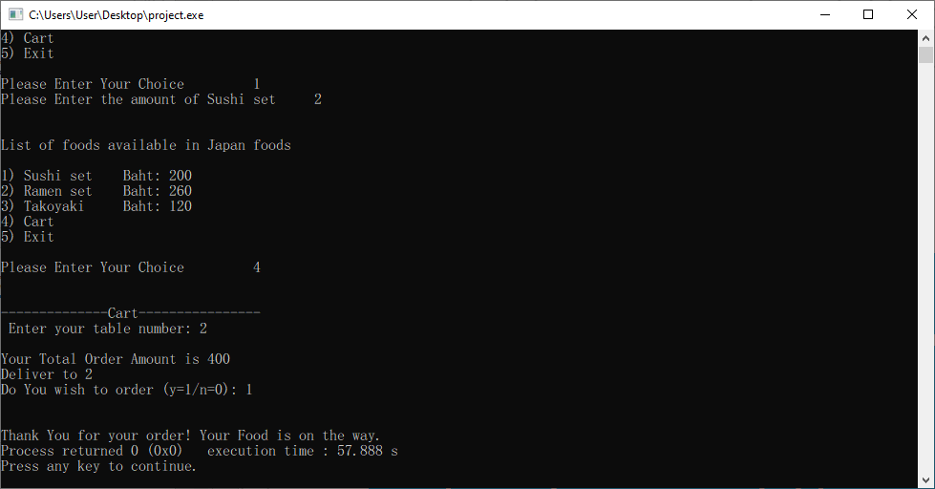
Features of the Program
If the user then confirms the order, the program will then terminate

Slide 13
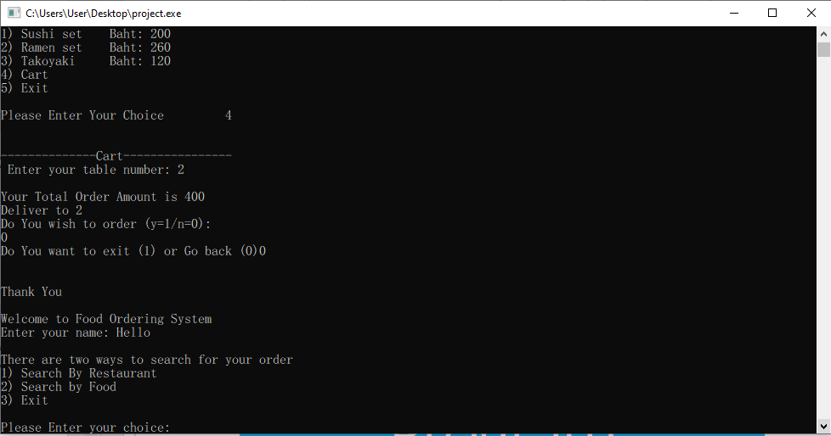
Features of the Program
If the user chooses not to confirm the order, the program then loops back to main and allows the user to order again

Slide 14
How can this project be improved
Maybe use a GUI (but for now it is too advanced for us)
Show the orders in the cart function for convenience
Add a function to show (print) a receipt
Maybe make a login screen to be able to save favorite menus or restaurants

Slide 15
Thank You Very Much for Listening

